Slide 1

Microstructure & Mechanical Properties of Air Based Cold Spray Additive Manufacturing
Presented by
Abdul Rahman (2025MEM1018)
Nachiket Gavade (2025MEM1035)
Prabhat Kumar (2025MEM1052)
Palak (2023MEB1364)
Presented to
Prof. Harpreet Singh

Slide 2
Contents
Thermal Spray and it’s advantages.
Cold Spray and it’s advantages.
Justification of air based cold spray.
Characterization techniques.

Slide 3
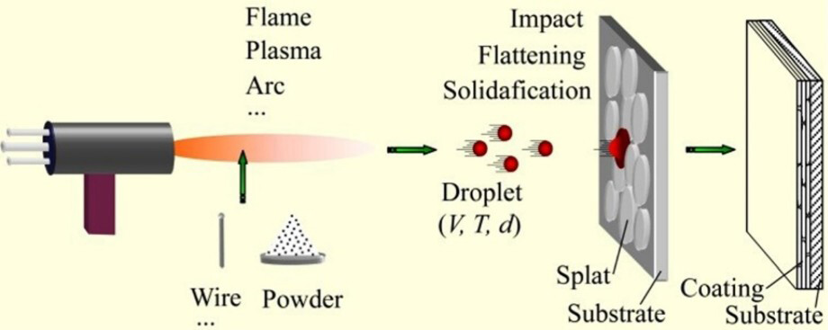
Thermal Spray
Thermal spray is an advanced surface engineering process that produces coatings by projecting heated feedstock particles which is molten or semi molten form onto a substrate at high velocity.
Upon impact, particles deform into thin lamellae and solidify, forming a dense protective or functional layer.
Schematic of Thermal Spray process
Source of Image:- www.thermalspray.com

Slide 4
Advantages of Thermal Spray
Wide material choice- metals, alloys, ceramics, carbides, composites.
Low heat effect on substrate- limited distortion and thermal damage.
Improved surface properties- wear, corrosion, oxidation, thermal protection.
Suitable for large components.
Repair and restoration capability- increases service life.

Slide 5
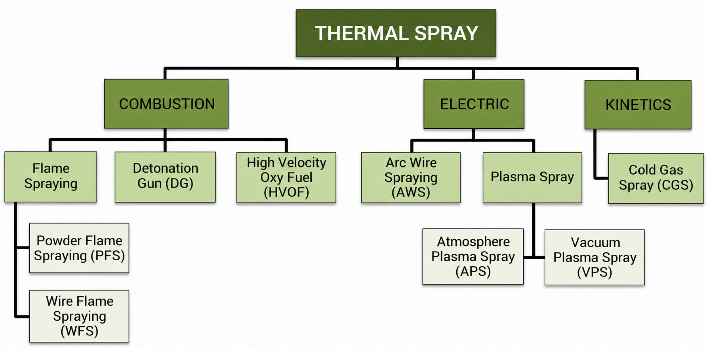
Types of Thermal Spray
Ref:Li, W., Cao, C., Wang, G., Wang, F., Xu, Y., & Yang, X. (2019). ‘Cold spray+’as a new hybrid additive manufacturing technology: a literature review. Science and Technology of Welding and Joining, 24(5), 420-445.

Slide 6
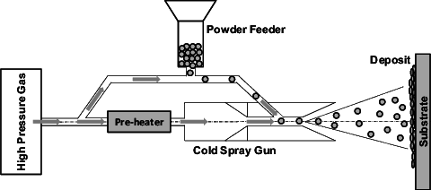
Cold Spray
Cold spray is a solid‑state additive manufacturing process where powder particles are accelerated to supersonic velocity and bonded by plastic deformation without melting.
Reference:- https://www.researchgate.net/publication/275719112_Characterization_and_Modeling_of_the_Bonding_Process_in_Cold_Spray_Additive_Manufacturing

Slide 7
Advantages of Cold Spray
Solid‑state process- minimal oxidation and phase change.
Low thermal effect- reduced distortion and residual stress.
Dense coatings with good adhesion, low porosity and good for plastically deformable materials like Al, Cu, Ti etc.
Useful for coating, repair and build a product.
Maintain its original feedstock properties.
Eco-friendly.

Slide 8
Why we are trying for air?
Simpler equipment setup.
Air can provide sufficient velocity for cold spray of many materials like Al, Cu, Zn.
It is economical.
Limitation
Chances of oxidation
Lower particle velocity
Reduce coating strength etc.

Slide 9
Characterization Techniques used for the analysis of the Air based Cold sprayed Deposits
XRD for the phase analysis
FE-SEM coupled EDS for the microstructure analysis with element analysis
Heat treatment for improve the inter splat bonding and reduce the porosity
Scratch test for analysis the inter splat- bonding of the deposits
Microhardness

Slide 10
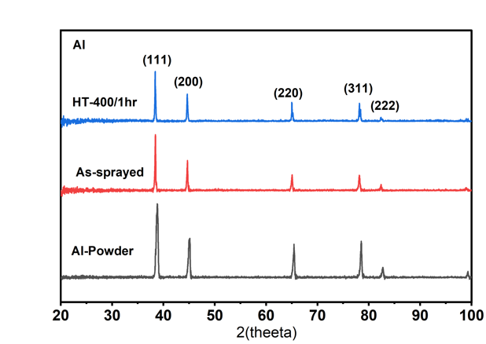
XRD Test
Al powder shows the FCC structure with the corresponding plane (111), (200), (220), (311), (222).
As sprayed sample, peaks are slightly broadened and reduced in intensity due to deformation during cold spray.
Heat treated peaks become sharper and more intense, indicating recovery of crystalline after heat treatment without any intermetallic formation at the selected temperature.
Intensity (a.u)
Figure: shows that the Al powder used for the deposition by the air-based cold spray, and as sprayed, and heat-treated sample XRD analysis

Slide 11
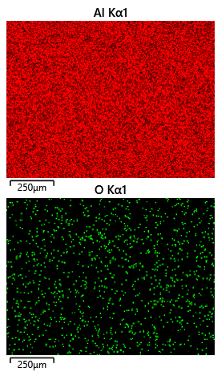
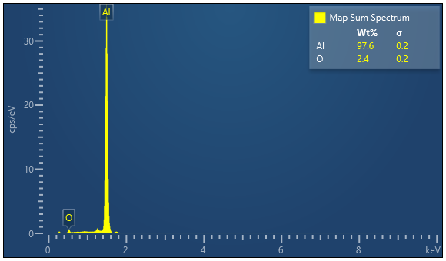
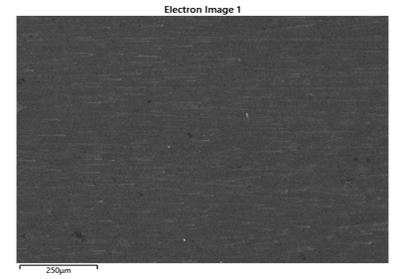
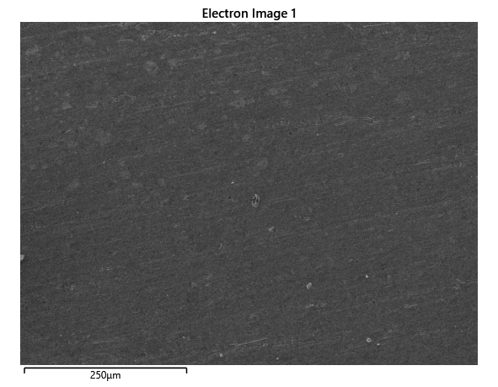
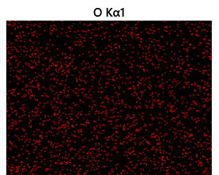

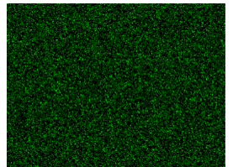
FE-SEM Characterization
Microstructure characterization of the as deposits and the Heat treated sample

Slide 12
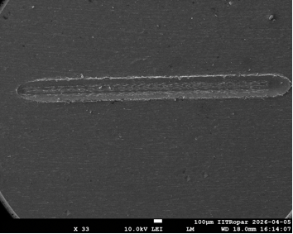
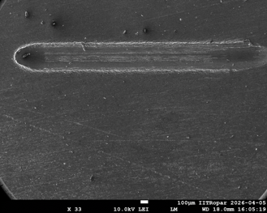
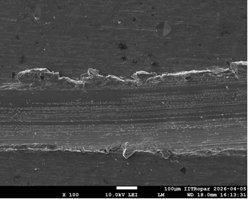
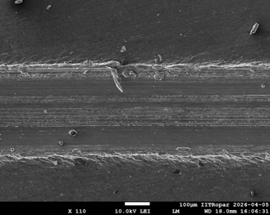
Scratch Testing
Using scratch tester machine, performing scratch test on both substrate for length of 3mm.
Velocity = 0.2 mm/s and load = 20 N.
FESEM Image of As Sprayed
FESEM Image of Heat Treated (400ºC/1hr.)

Slide 13
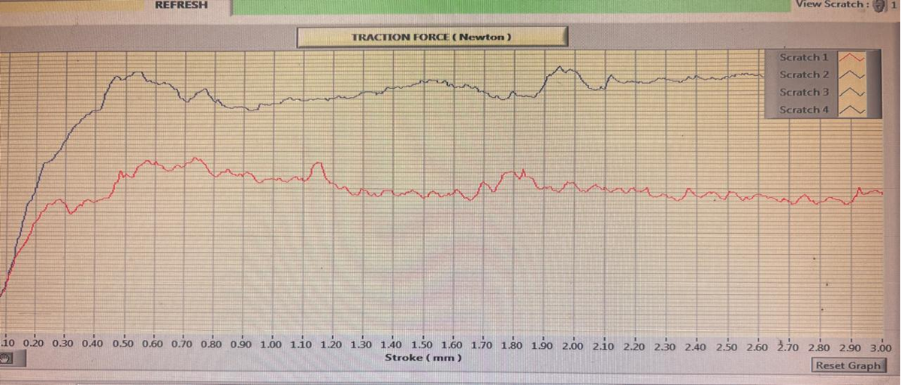
Graph
Coefficient of friction(COF) from the scratch test of the As-sprayed and Heat treated sample.

Slide 14
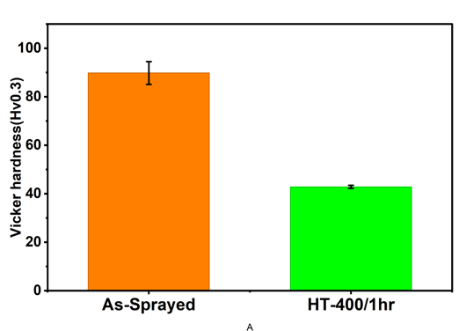
Micro-hardness test
This test is performed on Vickers hardness test machine.
Indent parameter - 0.3 kg load for 10 second.
Hardness Values
As Sprayed | Heat Treated (400ºC/1hr.)
87.9 HV | 43.2 HV
83 HV | 42 HV
87.9 HV | 42.6 HV
87.9 HV | 42.6 HV
78.5 HV | 43.8 HV
Average - 85.04 HV | Average - 42.84 HV

Slide 15
Conclusions
Air based CSAM is able to produce dense coating with minimum oxidation and thermal damage.
H.T(400°C/1hr.) enhance inter layer bonding, as shown by the scratch track.
XRD shows that the original phase of the powder remains unchanged after coating, which proves the advantage of the solid-state process.
Heat treatment(400°C/1hr.) helps the material to regain its original crystal structure, and no unwanted new phases are formed.
As Heat treatment effectively reduce the inter splat failure which beneficial for the corrosions and wear applications.

Slide 16
Acknowledge
CRF
Manufacturing lab
Your lab and our group mate
Prof. Harpreet Sir
IIT Ropar

Slide 17
Thank you

